Slide 1
Talking through trace gas paper story – too many things for one manuscript?
Disrupted N conference call,
2 April 2015

Slide 2
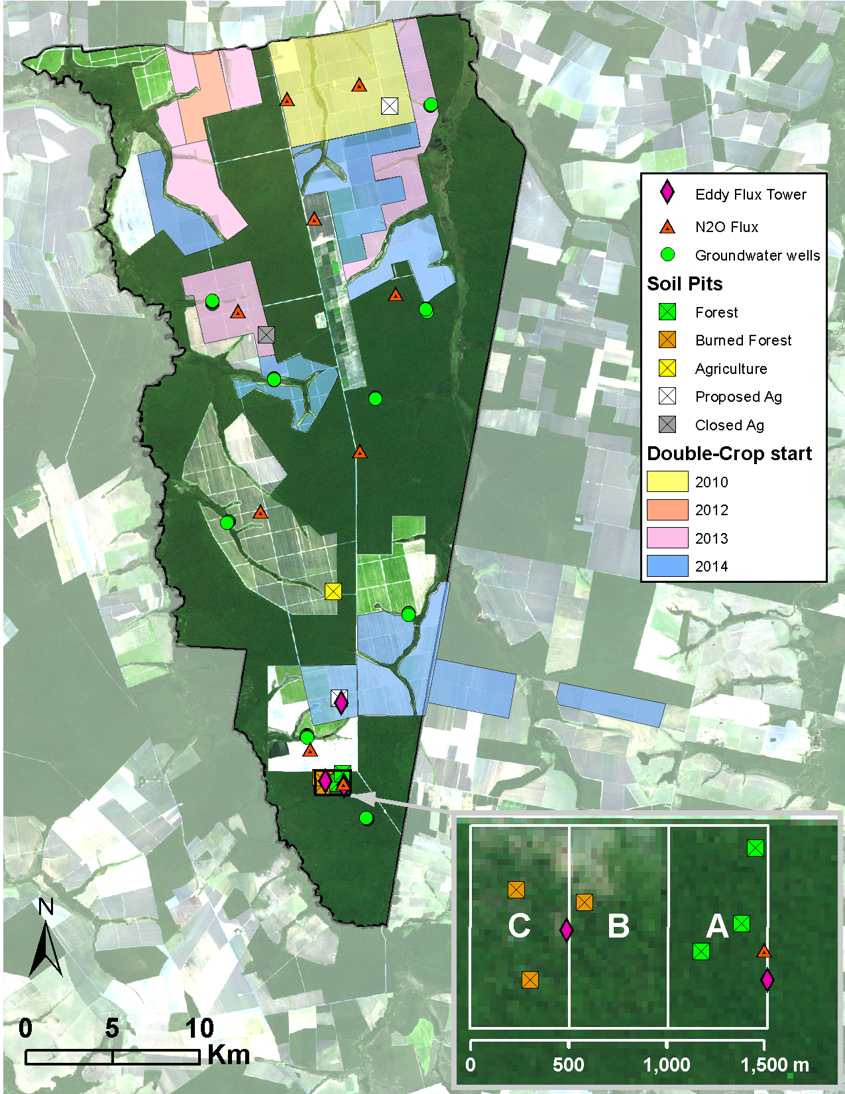
Three land uses (forest, soy, soy + corn), three sites per land use, sampling over 1.25 years Collected N₂O, CO₂, CH₄, soil vars
Notes:
Q: what soil vars to represent in a table?

Slide 3
Framing right now is:
Controls of GHG fluxes from agriculture in the tropics work differently than in the temperate zone for a bunch of reasons (delineate)
AAC, CEC, pH, clay content, seasonality, nutrient availability/limitation, microbial community, weathering history/rates
Many unknowns about biogeochem in tropical agricultural systems vs. tropical non-anthropogenic biomes
Mechanized agriculture is rapidly becoming the new norm in this tropical system (and likely others in the future)
Changing soil inputs in X, Y, Z ways may influence that specific tropical soil biogeochem in A, B, C fashion
Here, we ask how cropland intensification is changing GHG emissions at the plot and landscape level along a “new frontier” of agricultural intensification, given this important context of tropical soils
Notes:
Make sure to make it very clear what’s different about this system vs. temperate/other tropical places → how we might expect that to change trace gas emissions → what we’re not sure about those relationships
Mechanisms will work differently because of A, B, C
What we don’t know much about how those dynamics might play out
THEN give the one-two punch that this is especially relevant because of the rapid land use changes

Slide 4
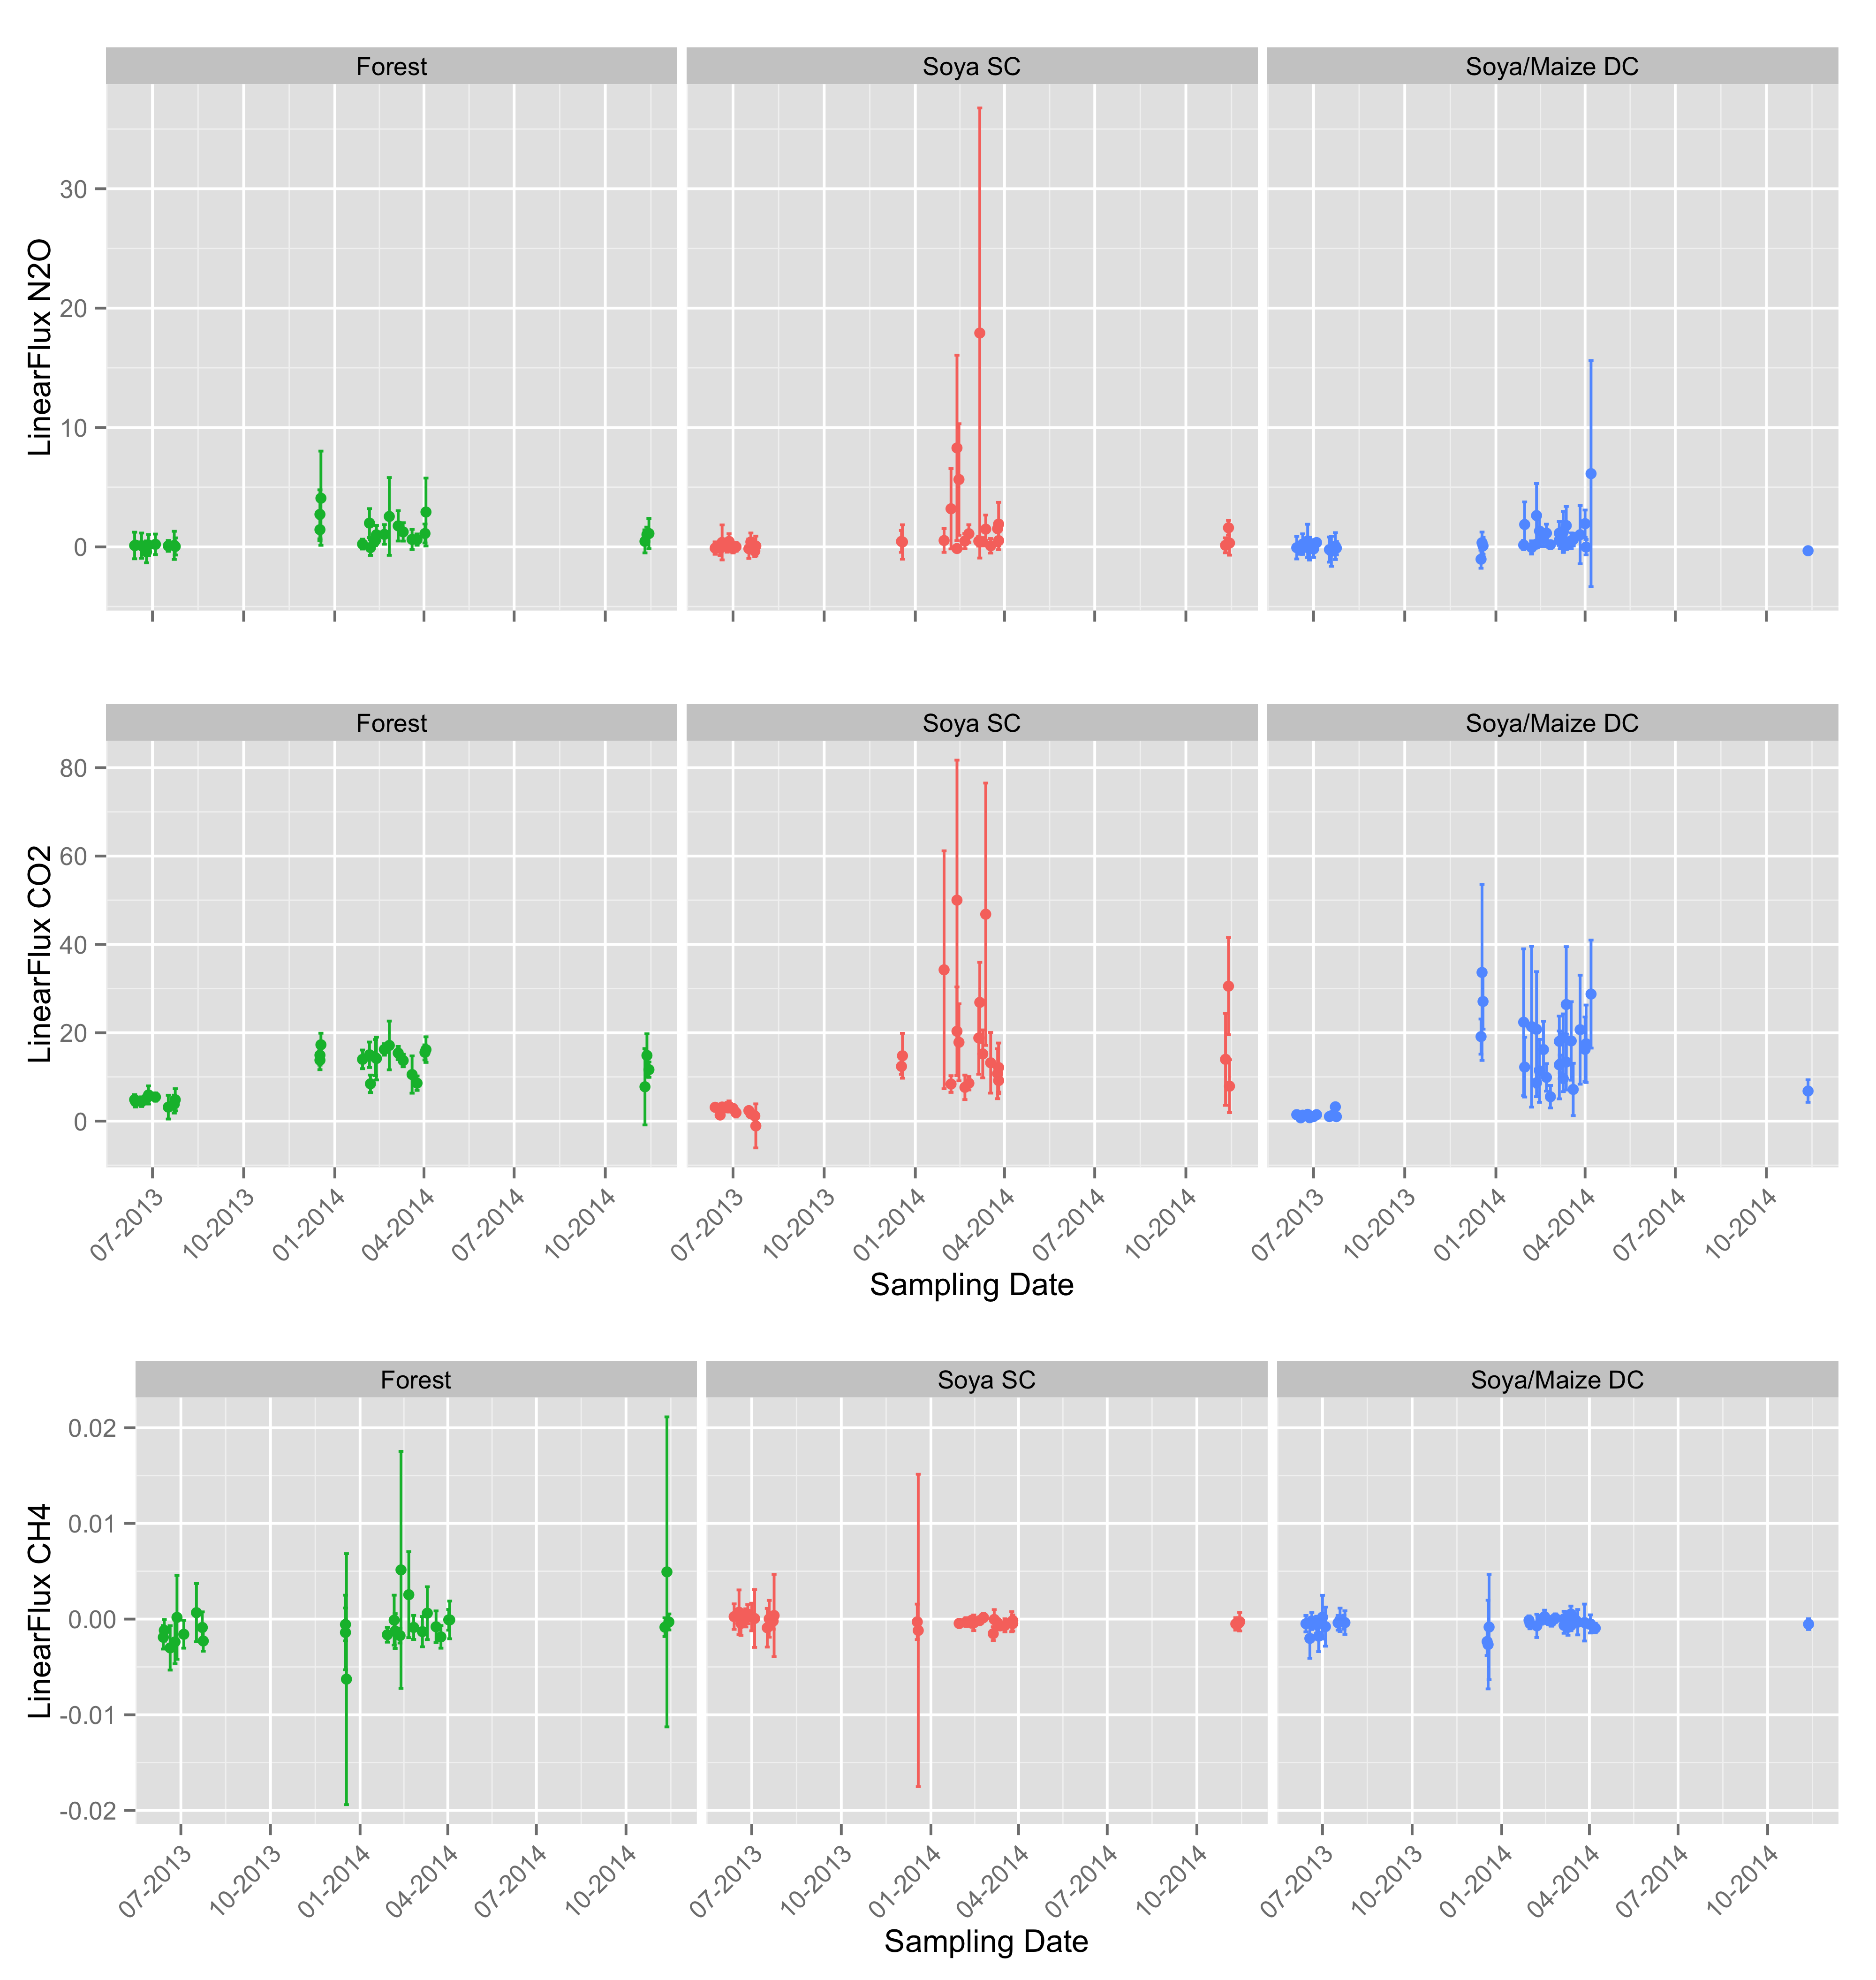
A. Trace gas emissions (plot level)

Slide 5
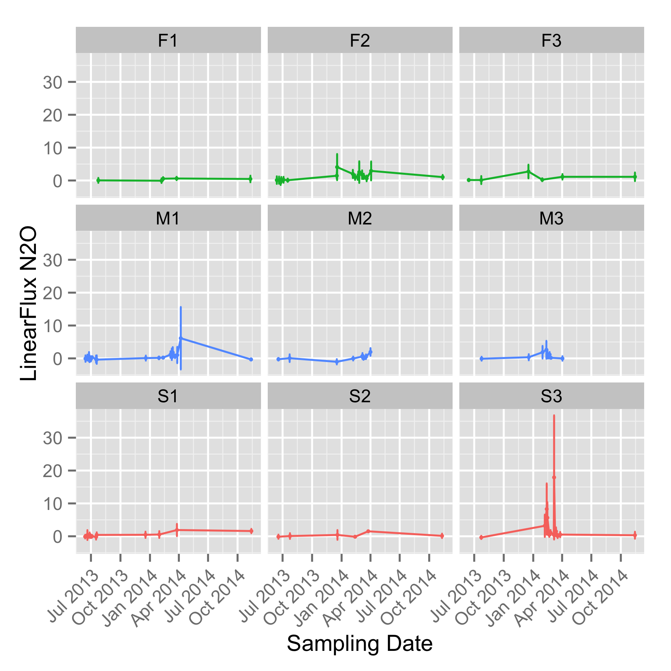
A. Trace gas emissions (plot level)
Notes:
Make sure to include context of how “big” fluxes are in comparison to other types of fert flux increases

Slide 6
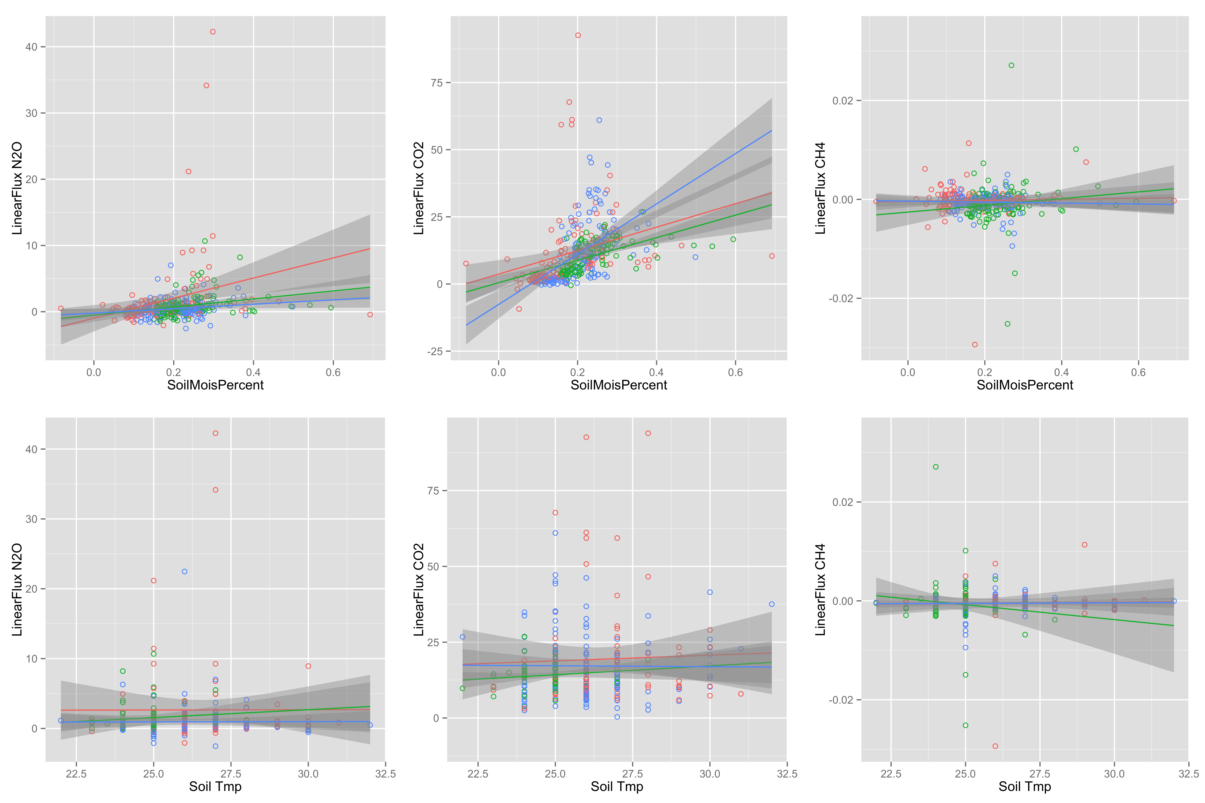
B. Soil variables (N pools/fluxes, C pools, WFPS, temp)
Notes:
Look up what type of test I should use to figure out regression shape
Include an interactive nitrate/moisture term in the model
NO:N2O ratio – include in discussion
Combine this data with the (A) results since they inform the emissions profiles

Slide 7
C. Trace gas emissions, seasonal + management extrapolation (back of the envelope)
This part it’s hard for me to work on without all of the soil data in… unclear which variables will be the best predictors
TBD!

Slide 8
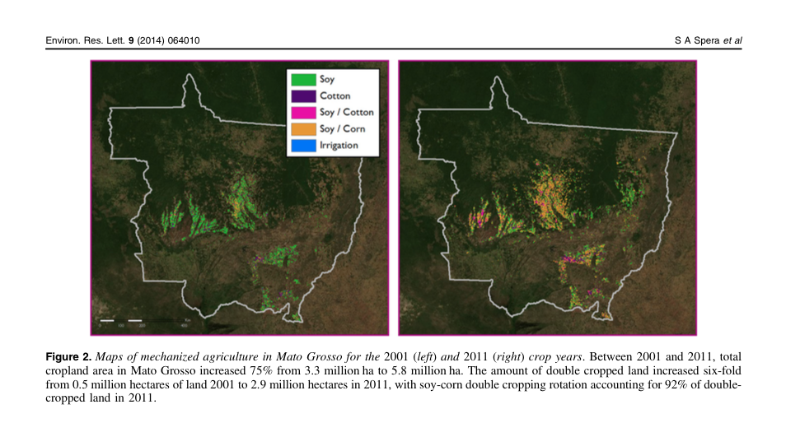
D. Apply to intensification in region, 2001-2011 (back of the envelope)
Notes:
Do some critical thinking about soil type at Tanguro and where at the larger scale it’s similar/different, and what that means for how these patterns can be interpreted

